Slide 1
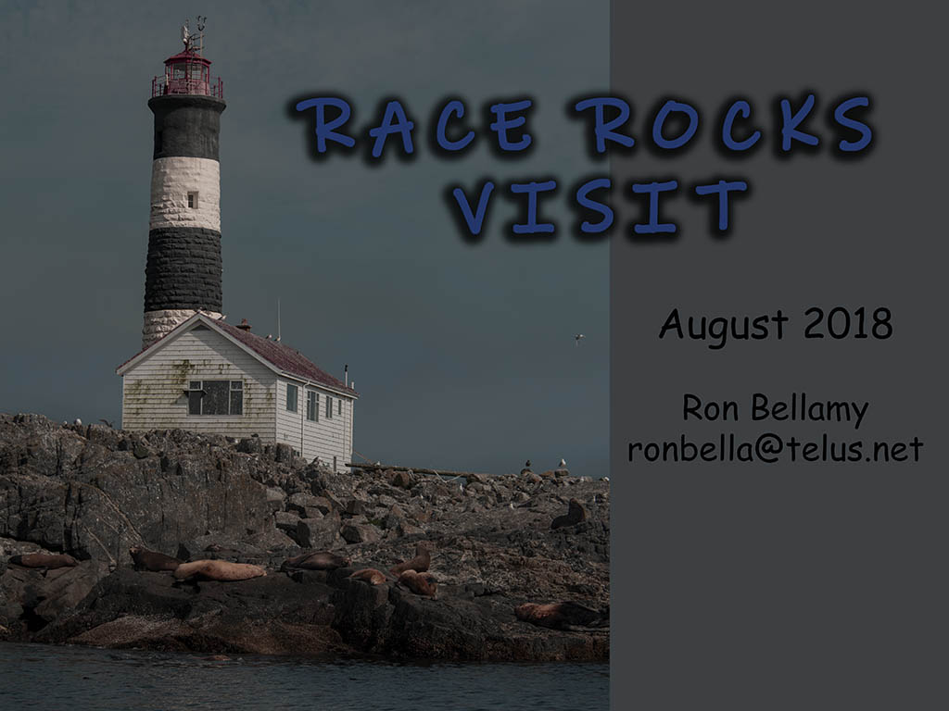

Slide 2
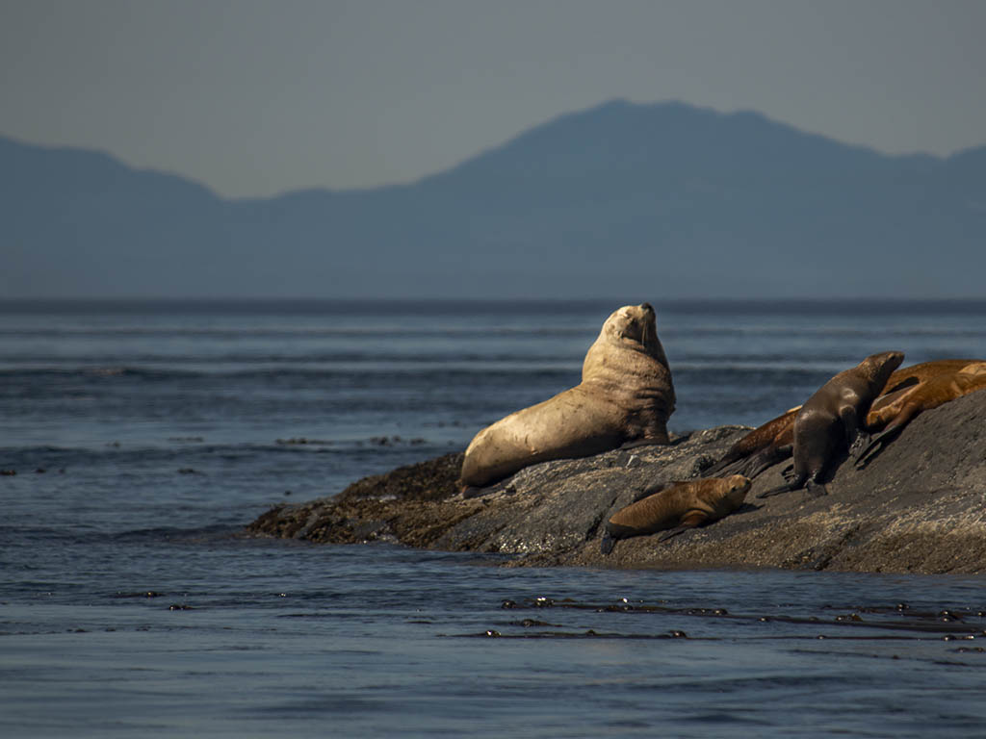
Steller’s Sea Lions

Slide 9
“Hmmm, now that the pups are asleep, I wonder what I should do with the rest of my day?”

Slide 15
licking his wounds

Slide 21
Sea Otter

Slide 30
“So sorry. I just couldn’t stifle that yawn.”

Slide 31
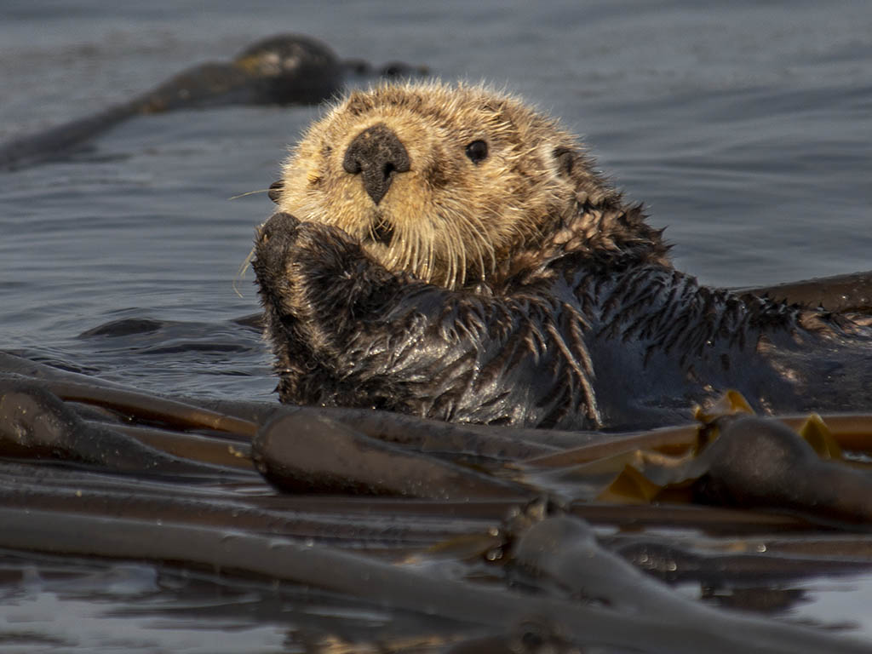
“Please forgive me. I won’t do it again.”

Slide 35
California Sea Lions

Slide 39
“Give me some space, man.”

Slide 40
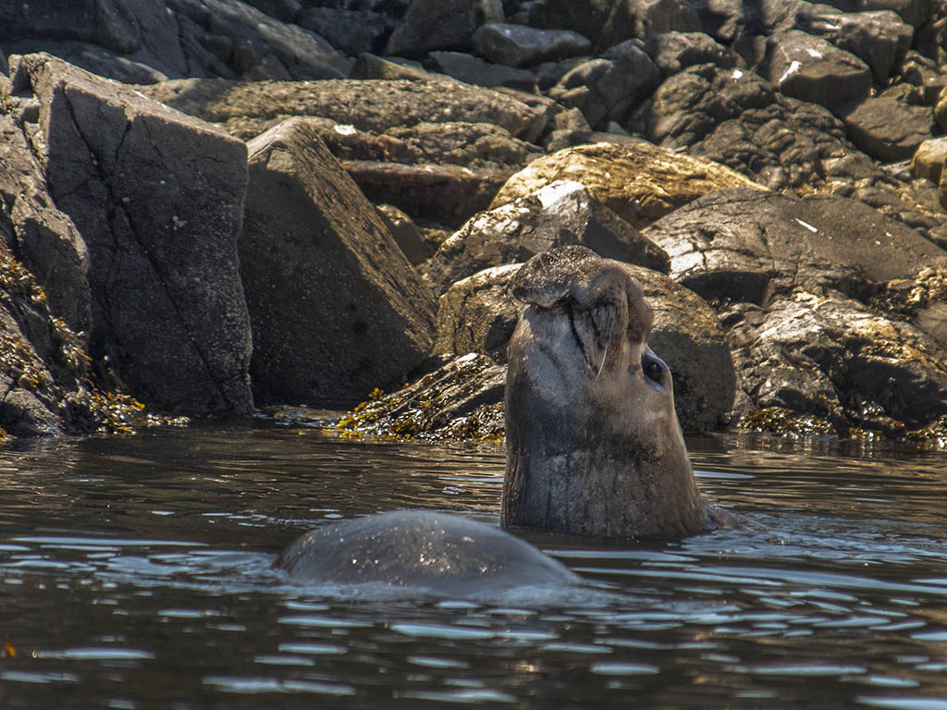
Northern Elephant Seal

Slide 43
Harbor Seals

Slide 44
“This Lazy-boy kelp is terrific.”
the end

